Slide 1
Dangers and Opportunities of Research with VQA
Derek Hoiem
VQA workshop

Slide 2
Surveyed 20+ papers, including survey and analysis papers
How is VQA used for research, and what improvements to evaluation can facilitate research?
“VQA: A Survey…”, Wu et al., Adelaide, CVIU 2017

Slide 3
VQA offers the opportunity of unique challenges
Disparate vision tasks specified with natural language
Embedding, grounding
Inductive transfer from other datasets
Requires a range of specialized skills
Compositional models
Requires new forms of task generalization
External knowledge
Inductive transfer from other datasets
Some questions are very hard to answer
How to make the system say “I don’t know”
figure: Goyal et al. CVPR 2017 (VQA v2 dataset paper)
See “VQA: A Survey…”, Wu et al., Adelaide, CVIU 2017

Slide 4
The impact of these interesting contributions is dominated by feature choice and training details
MLP model
“Revisiting VQA Baselines”, Jabri et al., Facebook, ECCV 2016
Jabri et al. conclude :
The best-performing methods are best at “cheating” (fitting the dataset biases)
Current models aren’t ready for VQA and hit the same ceiling
“May be necessary to consider alternative evaluation criteria”

Slide 5
The danger of VQA as a research problem
VQA’s current setup:
Encourages pattern matching approaches (huge train set)
Encourages doing well on most common questions (overall accuracy)
So:
Differences in features account for most variation in accuracy
Research contributions that impact a subset of skills or attempt to deal with the heavy tail have little measureable impact, discouraging some of the most interesting directions

Slide 6
How can we
maximize the opportunity
and
minimize the danger?

Slide 7
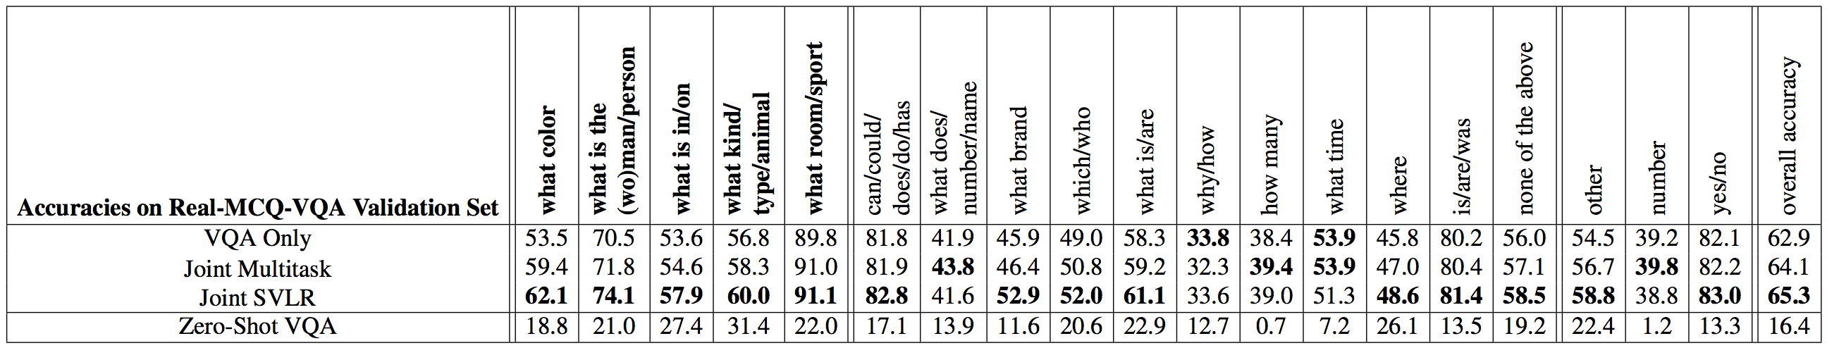
How do people currently evaluate using VQA?
Methods in papers that I surveyed
Standard (Overall + “Yes/No”, “Number”, “Other” breakdown): all
Customized question breakdown: 5 papers
Attention
analyze attention over small subset of photos: 2 papers
rank correlation of human and computer attention maps: 1 paper (Das et al.)
Generalization: correlate of accuracy and distance to similar training examples: 1 paper (Agrawal et al. “Analyzing the Behavior…”)
Detailed question breakdown by Gupta et al. ICCV 2017 (to appear)

Slide 8
Proposal: new standard evaluations
Assign “skill types” to questions and compute average accuracy over questions that require each skill
Use the VQA-HAT attention maps (with some modifications on quantitative analysis)
Explicitly evaluate generalization with new metric and mini-train set
Also, use multiple choice

Slide 9
“skill type” attributes
Object recognition
Attribute recognition
Scene recognition
Activity recognition
Spatial reasoning
Grounding
Counting
Reading
Brand recognition
Explanation
…
Skills: attribute, object, spatial reasoning, grounding

Slide 10
“skill type” attributes
Object recognition
Attribute recognition
Scene recognition
Activity recognition
Spatial reasoning
Grounding
Counting
Reading
Brand recognition
Explanation
…
Skills: object

Slide 11
“skill type” attributes
Object recognition
Attribute recognition
Scene recognition
Activity recognition
Spatial reasoning
Grounding
Counting
Reading
Brand recognition
Explanation
…
Skills: activity

Slide 12
“skill type” attributes
Object recognition
Attribute recognition
Scene recognition
Activity recognition
Spatial reasoning
Grounding
Counting
Reading
Brand recognition
Explanation
…
Skills: object, attribute, grounding, external knowledge

Slide 13
“skill type” attributes
Q: How many glasses?
A: 4
Object recognition
Attribute recognition
Scene recognition
Activity recognition
Spatial reasoning
Grounding
Counting
Reading
Brand recognition
Explanation
…
Skills: object, counting

Slide 14
“skill type” attributes
Q: What does this guy’s shirt say?
A: “Emerica”
Object recognition
Attribute recognition
Scene recognition
Activity recognition
Spatial reasoning
Grounding
Counting
Reading
Brand recognition
Explanation
…
Skills: object, grounding, reading

Slide 15
Evaluating attention by Das et al.
Attention annotations
Evaluate with Spearman rank correlation of positions within each image
Found that existing methods substantially underperform a center bias or salience
“Human Attention in VQA…”, Das et al., Facebook/VTech, EMNLP 2016

Slide 16
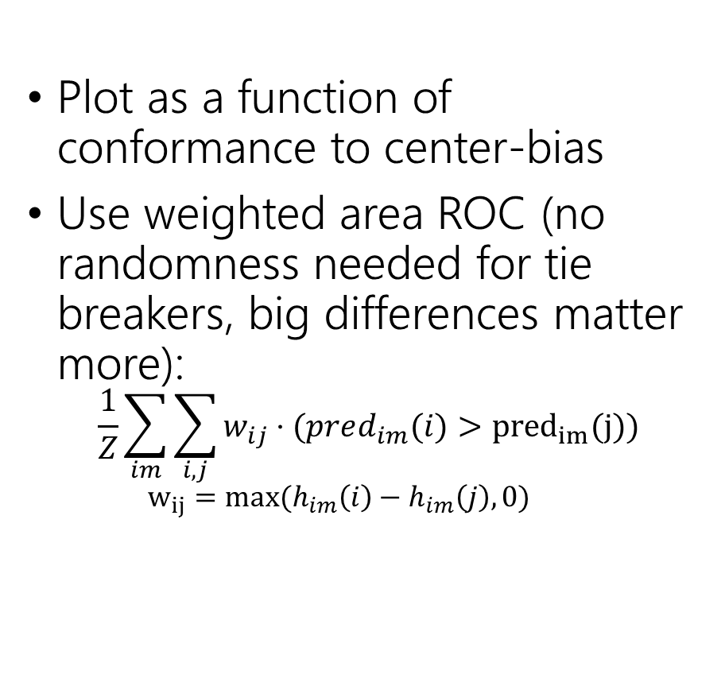
Controlling for center-bias
Plot as a function of conformance to center-bias
Use weighted area ROC (no randomness needed for tie breakers, big differences matter more):
$$\frac{1}{Z}\sum_{im}{\sum_{i,j}{w_{ij}}⋅(pred_{im}(i)}>{pred}_{im}(j))$$
$${w_{ij}=max⁡(h}_{im}\left(i\right)−h_{im}\left(j\right),0)$$
Degree of Center Bias (cumulative)
Thanks to Kevin Shih for doing much work on evaluation metrics and figures for these slides

Slide 17

Controlling for center-bias, weighted ROC
Plot as a function of conformance to center-bias
Use weighted ROC (no randomness needed for tie breakers, big differences matter more):
$$\frac{1}{Z}\sum_{im}{\sum_{i,j}{w_{ij}}⋅(pred_{im}(i)}>{pred}_{im}(j))$$
$${w_{ij}=max⁡(h}_{im}\left(i\right)−h_{im}\left(j\right),0)$$
Degree of Center Bias (cumulative)
Degree of Center Bias (cumulative)
Thanks to Kevin Shih for doing much work on evaluation metrics and figures for these slides

Slide 18
Consider correlation of position across images
Weighted AUC
 | Random | Center Bias | Salience | HiCo | SAN2 | WTL | SVLR | Human
Correlation Across Position for Each Image | 0.5 | 0.770 | 0.714 | 0.662 | 0.671 | 0.7039 | 0.767 | 0.839
Correlation Across Images for Each Position | 0.5 | 0.5 | 0.560 | 0.605 | 0.577 | 0.563 | 0.623 | 0.680
Average Correlation Across Images for each Position
Salience: based on edge boxes
Human: inter-human correlation
HiCo: “Hierarchical Question-Image Co-Attention …”, VTech/GTech, NIPS 2016
SAN2: “Stacked Attention Networks …”, CMU/MSFT, Yang et al., CVPR 2016
WTL: “Where to Look…”, UIUC, Shih et al., CVPR 2016
SVLR: “Aligned Image-Word Representations…”, UIUC, Gupta et al., ICCV 2017

Slide 19
Consider correlation of position across images
Average Correlation Across Positions for each Image
 | Random | Center Bias | Salience | HiCo | SAN2 | WTL | SVLR | Human
Spearman Rank Correlation | 0 | 0.533 | 0.398 | 0.270 | 0.259 | 0.376 | 0.481 | 0.624
Weighted ROC | 0.5 | 0.770 | 0.714 | 0.662 | 0.671 | 0.7039 | 0.767 | 0.839
Average Correlation Across Images for each Position
 | Random | Center Bias | Salience | HiCo | SAN2 | WTL | SVLR | Human
Spearman Rank Correlation | 0 | 0 | 0.103 | 0.181 | 0.148 | 0.115 | 0.223 | 0.358
Weighted ROC | 0.5 | 0.5 | 0.560 | 0.605 | 0.577 | 0.563 | 0.623 | 0.680
Salience: based on edge boxes
Human: inter-human correlation
HiCo: “Hierarchical Question-Image Co-Attention …”, VTech/GTech, NIPS 2016
SAN2: “Stacked Attention Networks …”, CMU/MSFT, Yang et al., CVPR 2016
WTL: “Where to Look…”, UIUC, Shih et al., CVPR 2016
SVLR: “Aligned Image-Word Representations…”, UIUC, Gupta et al., ICCV 2017

Slide 20
Evaluating generalization through a metric
Three ideas to measure rareness of question:
Compute Q/A probability with tri-gram model (downside is that long sentences will tend to have lower probability)
Probability of least common word
Average distance to K-NN for Q/A in an embedding space
(Agrawal et al. “Analyzing the Behavior…”, VTech, EMNLP 2016)
Make three rareness categories (e.g. divide into thirds according to rarity) and evaluate accuracy of each subset

Slide 21
Evaluating generalization through experiment
Create a mini-train set of 1000 (for instance) examples
Should be enough to learn format of VQA, but not enough to learn how to answer each question from VQA
Evaluate on val/test
Good test for cross-dataset (inductive) transfer from non-VQA tasks such as recognition

Slide 22
Use multiple choice instead of open-ended question answering
Main additional challenge of open-ended is in narrowing down the options based on question type, places more importance on learning dataset pattern (“bias”)
Multiple choice is a cleaner evaluation

Slide 23
Conclusion
VQA creates opportunities for studying task generalization and learning to perform tasks specified with natural language
Current standard evaluations may inhibit research by encouraging treating VQA as multimodal pattern recognition
We should create a standardized extended evaluation to facilitate the unique directions afforded by VQA
skill types
attention metric
generalization metric
mini-train set

Slide 24
Thank you
Proposal: create a standardized extended evaluation to facilitate the unique directions afforded by VQA
skill types
attention metric
generalization metric
mini-train set

